Slide 1
Online Movie Booking
Created by Natraj Chigarambatla

Slide 2
Table of Contents
Application Overview
Architecture Components
Data Model
Project Plan
Non Functional Requirements
Design practices

Slide 3
Overview
Online Movie booking is a online platform which list all the movies to the user that are currently running in the city when application is launched
The app will provide different movies listing based on the city chosen by the user
Users can browse theatres based on the chosen movie, show date, show time and city they are interested in
Users can also browse all shows for the given theatre for a given date
Platform has capability to integrate with theatres which allows them to add/remove/update the movie shows listing for their theatre

Slide 4
Overview
Theatres can allocate seat inventory or remove the seats
Users will be provided with offers while booking the show for noon and 3rd ticket. Offers can be added or removed or modified. However implementation could be needed for any such changes that gets introduced
User get insights of the movie details that include the rating, censor grade, reviews and cast crew
Platform currently support payment via third party interaction for seats booking where in user will be redirected to payment page after taking confirmation to proceed booking within our app. Once the payment is done, will be redirected back to application for ticket booking confirmation

Slide 5
Overview
A registered user can perform below:
Add rating and post comment for a particular movie plus giving edit/delete option
Get order history
View/Edit profile
Ability to cancel single/bulk ticket
View ticket
All show tickets can also be sent for the cancellation
Theatre can be queried to get its details such as address
For any failed booking, seats will be unlocked after certain time (periodic scheduler thread is defined that wait for certain time before marking order as failed)

Slide 6
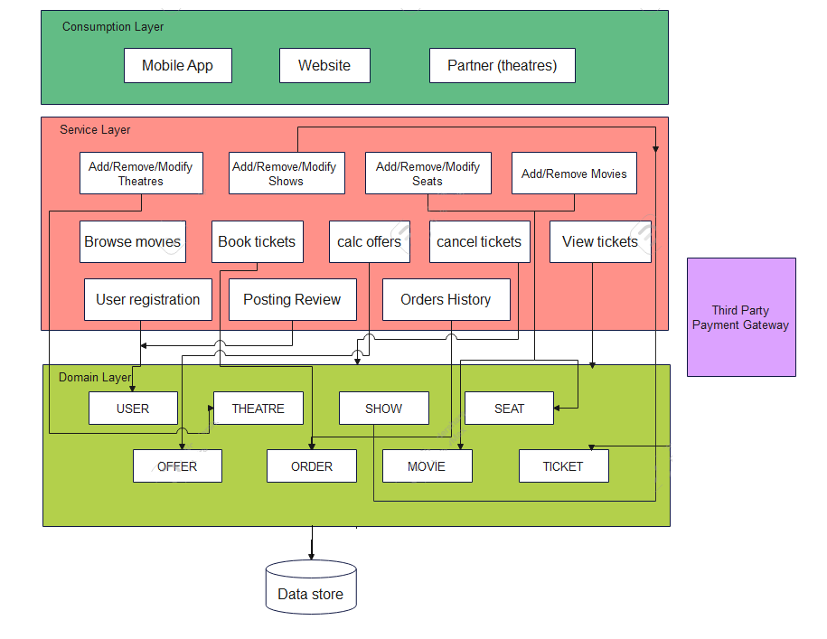
Architecture components

Slide 7
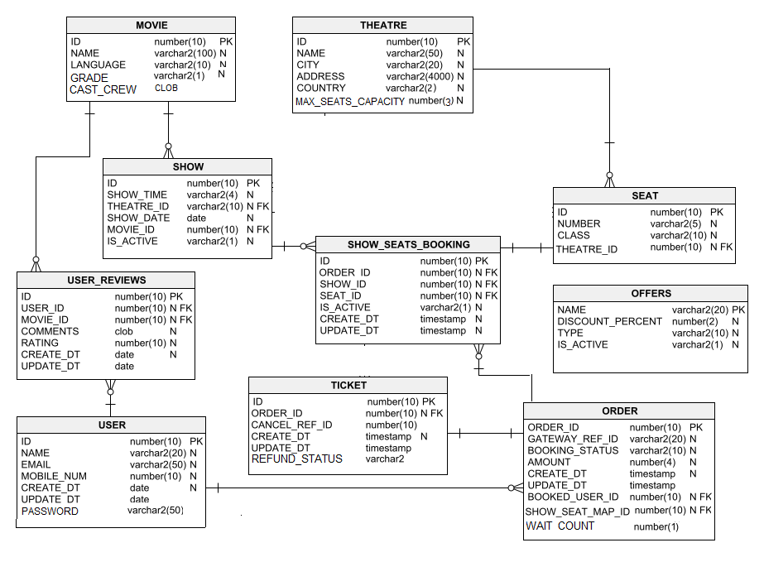
Data Model

Slide 8
Project Plan
We would follow the agile scrum for planning and execution of the deliverables which adhere to below practices :
Definition of Done (Acceptance criteria met, peer reviews, unit testing, security scan, QA (ST/PT), UAT/Prod Readiness)
Definition of Ready (INVEST principle)
Estimation Guidance (TShirt Size, Story points, Development Days/Hrs)
Scrum Ceremonies (Daily Status, PBR, Sprint Planning/Review/Retrospective)
Setup a Jira and Repository Branching strategy workflow
Run a weekly architecture calls within tech team that focus improving product discussing design challenges (for resilient/scalable) and performance

Slide 9
Project Plan
SPRINT DETAILS | PLANNING DATE | START DATE | END DATE | SPRINT CLOSED DATE | SPRINT REVIEW DATE | EXPECTED SPRINT GOAL | ACTUAL GOAL | SPRINT DEMO COMMENTS
Sprint 0
Sprint 1

Slide 10
Sprint Goals
Applicable goals for the previous slide are prioritised into below:
Movies listing
Search capabilities
Booking tickets
Add/Remove/Update shows
Add/Remove/Delete seats
Cancel tickets
User registration
Posting reviews

Slide 11
Product backlog refinement
STORY CARDS FOR PBR | PBR START DATE | PBR END DATE | END DATE | SPRINT | QUERIES TO CHECK IN PBR | STATUS | ADJUST AS PER PBR COMMENTS
CARD 0
CARD 1

Slide 12
Non Functional Requirements
Multiple approach can be considered for securing the application:
IDA (Single Sign on)
JWT/JDBC authentication via Spring Security having configurable TTL
Can also be enabled in API Gateway as this is the entry point for all service request, I assume that have a firewall in place, this could restrict inbound traffic to micro services and disallow anyone from accessing the microservices directly.
LDAP
IAM

Slide 13
Non Functional Requirements
Scalability can be further divided into business and infrastructure.
Business scalability : Taking an example of Movie Booking, we can extend to multiple countries as we already have model configured to support expansion
Infrastructure scalability : We can make application cloud native that can support the load balancing (through Spring Cloud Load Balancer/ Ngix) based on the traffic. (Kubernetes (Openshift can be used for management) or Cloud service provides like AWS which contains bucket of managed services. Spring boot provides works in well to support scaling through service discovery
Availability can be achieved if there are disaster recovery systems are in that place which the cloud providers offer incase of failure but Spring Cloud Load Balancer can be used to serve during heavy traffic
Zipkin can be used to support logging and request tracing in case of faults (API gateway can meets the needs if we consider only one microservice)
Spring actuator services can be used for checking the health of the app
Resilience4J can be used to Fault/latency tolerance
Concurrency issue is handled by defining unique constraint at the entity level

Slide 14
Non Functional Requirements
Integration with payment gateway would require a merchant account registered with third party that provide payment services.
Monetisation :
Can done by integrating with digital advertising services like Google Ads product.
Also theatres can pay based on the fixed rate or variable rate. In a variable structure, theatres can pay based on the number of shows that are being hosted on the app per month with any additional decisions based on budget of the movie.
Users can also be encouraged with wallet by supporting discount on every booking. App can also offer for buying plans wherein there is certain percent discount is offered on each booking

Slide 15
Design Practice
In our scenario we considered everything as a single microservice. We can follow DDD model where domain can further be divided into sub-domains (Show, User, Theatre etc) where each is solution is bounded context (boundary defined to serve only for a domain model). Each bounded context can itself be considered mini application containing its own persistance model and code base.
Based on the complexity, each microservice can be broken into granular responsibilities with its own microservice
app-ui
app-decision-support
app-data-services
app-workflow

